Slide 1
MACHINE LEARNING FINAL
Predicting NVIDIA Stock Return Percentage Using a Machine Learning Approach
Justin Yuslih -00000120765
YustinusEvan Kusuma -00000119455
Ivan Michael Lawrence Sanjaya -00000119085 Bryant Marchianno Jefferson -00000116382 Aufa Dana Murtadha -00000114587
Source: MachineLearningFinalBanget (1).ipynb
01

Slide 2

BACKGROUND
Background
Stock prices in the market frequently fluctuate over time. One stock that attracts significant investor attention is NVIDIA. To understand these price changes, analysis requires more than just looking at the stock price itself, but also examining the return percentage, which is the percentage change in price over a period. Therefore, this study created a machine learning model to predict NVIDIA's stock return percentage based on historical price data.
Source: MachineLearningFinalBanget (1).ipynb
02

Slide 3
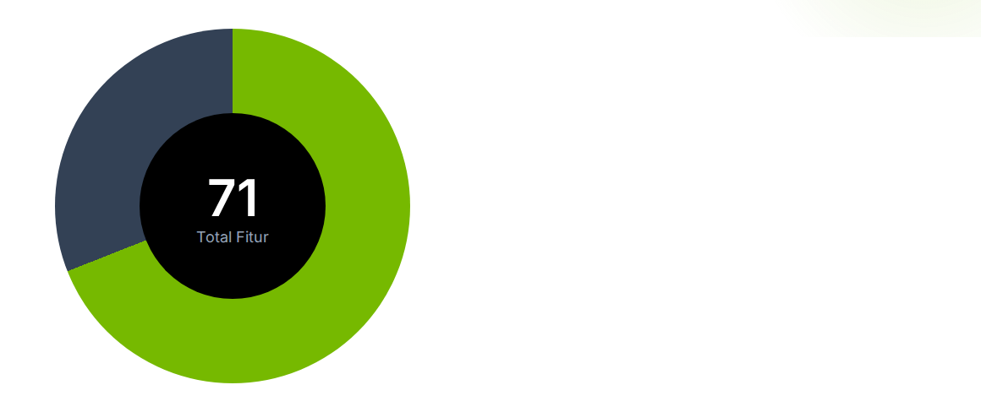
BACKGROUND
Dataset Feature Composition
Variable Distribution
69% Engineering Features (49 Features)
31% Original Features (22 Features)
Engineered Features: Includes external market context (VIX/SMH), momentum indicators (RSI/MACD), and temporal lag.
Original Features: Based on underlying OHLCV (Open, High, Low, Close, Volume) data from Yahoo Finance.
Source: MachineLearningFinalBanget (1).ipynb
02

Slide 4
BACKGROUND
Data Preparation Statistics
6,870
6,529
Trading Day
Trading Day
Before
After
Cleaning Note: 291 rows (NaN) were removed after the generation of lag and moving average features to ensure temporal validity. Scaling was performed using RobustScaler on the BiLSTM model.
Source: MachineLearningFinalBanget (1).ipynb
02

Slide 5
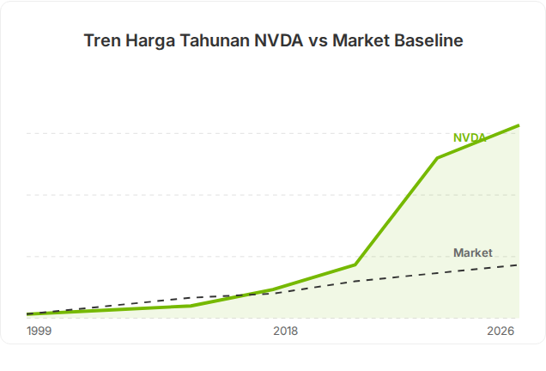
BACKGROUND
Price Performance Comparison
Historical analysis of NVDA prices against national market movements (US Market).
There will be an exponential surge in the 2023-2026 period driven by the AI ​​cycle. This requires ML models to be highly sensitive to white-noise data.
The accuracy of the regression model is highly influenced by exogenous features such as the VIX and SMH Index to maintain temporal validity.
Source: MachineLearningFinalBanget (1).ipynb
02

Slide 6

URGENCY & STATISTIC
Urgency
1. NVIDIA's stock price often experiences rapid fluctuations along with technological developments, particularly in the fields of Artificial Intelligence and the semiconductor industry.
2. Significant stock price changes can impact investor returns, making analysis of the percentage change in price (return percentage) important.
3. Investors and analysts need methods that can help understand stock price change patterns based on historical data.
4. By utilizing machine learning models, stock price change patterns can be studied from previous data, helping to provide an overview of possible future return movements.
Takeaway: This research is important because it tests whether the latest market features and XAI can make NVDA predictions more
transparent in the period 1999-2026.
Source: notebook output and final evaluation metrics

Slide 7
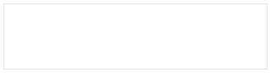
RESEARCH PURPOSES
Research outputs focus on pipelines, model evaluation, and interpretation of results.
01
Building an NVDA dataset
02
Testing ML models
Combines OHLCV, VIX, SMH, volatility proxy, earnings, lag, volume flow, and relative strength.
RF,XGBoost, LightGBM, BiLSTM-Attention, Ridge, SVR, and Stacking Ridge Meta.
03
Evaluate rolling
04
Comparing journals
Measuring return metrics and price rolling metrics over the last 3 months window.
Create a research gap and competitive table for CEEJ 2021 and supporting literature.
Interpretation limitations: these results are analytical baselines and academic experiments, not automated trading recommendations.
Source: MachineLearningFinalBanget (1).ipynb
03

Slide 8
RESEARCH GAP
The literature is strong on models, but gaps still exist in the latest NVDA, rolling evaluation, and XAI.
Journal | Focus | Gap | Relevance to notebook
Chlebus et al. 2021 CEEj | Investigated NVIDIA stock return prediction using more than 350 financial variables and compared multiple machine learning models including SVR, KNN, XGBoost, LightGBM, LSTM, and ensemble approaches. The study emphasized the effectiveness of combining different prediction techniques in financial forecasting. | The dataset only covered market conditions until 2018 and therefore did not capture major structural changes such as the AI-driven semiconductor boom, post-pandemic recovery, and recent market volatility. The authors also found that ensemble models did not consistently outperform individual models due to high noise levels and non-stationary stock market behavior. Furthermore, explainable AI methods were not incorporated to interpret model decisions. | This notebook extends the analysis to data up to 2026, allowing evaluation under more recent market regimes. Additional macroeconomic and volatility indicators such as VIX, SMH ETF, earnings-related variables, and rolling price features are included. Explainable AI through SHAP analysis is also applied to improve model interpretability and identify key drivers of NVIDIA stock movement.
Reddy (2018), IRJET | Applied Support Vector Machine with RBF kernel for stock market prediction using a limited set of technical indicators and handcrafted features. The study focused on demonstrating the predictive capability of SVM in financial classification tasks. | The research explored only a narrow machine learning space centered around SVM. Modern algorithms such as gradient boosting, random forests, deep learning architectures, hybrid models, and ensemble techniques were not evaluated. Feature engineering was also relatively limited and did not incorporate macroeconomic or sector-level information. | This notebook evaluates a broader range of machine learning families including tree-based methods, support vector regression, deep learning models, and ensemble approaches. More than 70 engineered features are incorporated, covering technical, volatility, sector, and market-wide indicators, enabling a more comprehensive comparison of predictive performance.
Kumbure et al. (2022), ESWA Review | Conducted a comprehensive review of 138 machine learning stock forecasting studies, analyzing thousands of variables, algorithms, and forecasting approaches used in the literature. The paper provides a broad overview of the state of the art in stock prediction research. | As a survey paper, the study synthesizes prior findings but does not provide a focused empirical evaluation on a specific stock. The review also predates the recent AI-driven growth period of NVIDIA and therefore cannot assess how modern machine learning models perform on this unique market phenomenon. | This notebook serves as a concrete empirical implementation of the trends identified in the review. By focusing specifically on NVIDIA, one of the most influential AI-related stocks, the study evaluates how multiple machine learning approaches perform in a real-world forecasting scenario using recent data.
Sources: CEEJ 2021; IRJET 2018; Kumbure et al. 2022; Tran et al. 2024; Gulmez 2023
04

Slide 9
RESEARCH GAP
The literature is strong on models, but gaps still exist in the latest NVDA, rolling evaluation, and XAI.
Journal | Focus | Gap | Relevance to notebook
Tran et al. (2024), Nature HSSC | Examined stock market forecasting for Vietnam's VN-Index and VN30 using LSTM networks combined with technical indicators. The study demonstrated the ability of deep learning models to capture nonlinear relationships in emerging financial markets. | The analysis is highly market-specific and limited to Vietnamese stock indices. It does not investigate U.S. equities, semiconductor stocks, or NVIDIA. The feature set mainly relies on technical indicators and does not incorporate extensive external variables, rolling market features, or explainability frameworks. | This notebook focuses on the U.S. market and NVIDIA stock, which exhibit different dynamics from emerging markets. Additional market-wide variables, sector indicators, volatility measures, and explainability techniques such as SHAP are included to provide both predictive and interpretive insights.
Gulmez (2023), ESWA | Proposed a Deep LSTM framework optimized using the Artificial Rabbits Optimization algorithm to improve stock forecasting accuracy. The study primarily investigated optimization strategies for deep learning architectures. | The research concentrated on improving a single deep learning model rather than comparing fundamentally different model families. External variables and broader feature engineering were limited, and the study did not investigate whether simpler machine learning models could achieve competitive performance. Explainability analysis was also absent. | This notebook compares multiple model categories including decision trees, random forests, gradient boosting, support vector regression, BiLSTM-Attention networks, and stacking ensembles. The study also integrates exogenous variables and SHAP explanations, enabling both performance comparison and model interpretability.
Sources: CEEJ 2021; IRJET 2018; Kumbure et al. 2022; Tran et al. 2024; Gulmez 2023
04

Slide 10
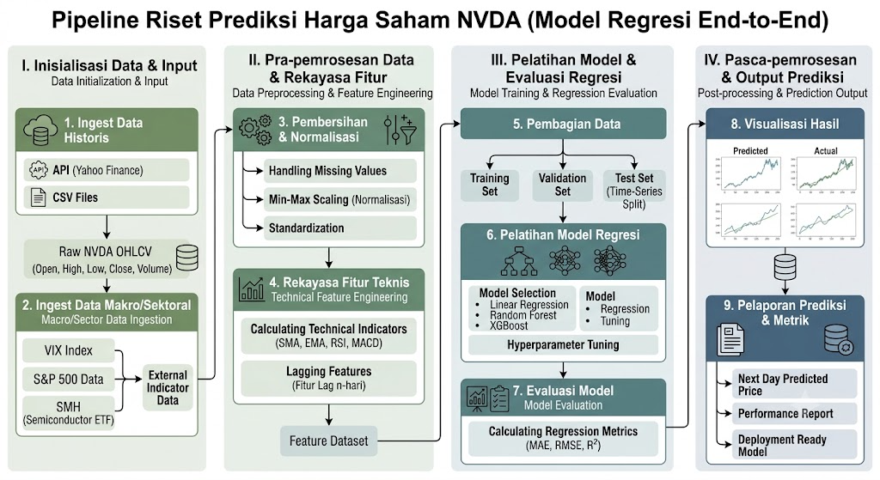
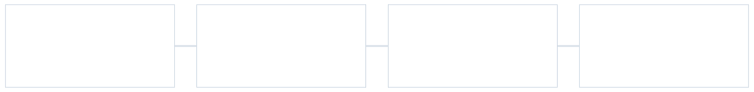
RESEARCH PIPELINE
The pipeline is structured from raw data to rolling and SHAP BiLSTM evaluation.
01
Data gathering
02
Cleaning
03
Feature engineering
04
Split time-based
NVDA daily OHLCV via yfinance + VIX, SMH, SPY/QQQ context, earnings, IV proxy
flattencolumns, align time index, delete
71features: technical, volatility,
70% train, 15% validation, 15% test; without
NaNafter feature engineering
lag/momentum, volume flow, relative strength
random shuffle
05
Tuning
06
Feature selection
07
Model evaluation
08
XAI + conclusion
Optuna for hyperparameters of each model family
Permutation importance in the validation set; Top-N fallback if the threshold is too strict
MAE,RMSE, R2, DA, rolling price
SHAPBiLSTM from the request image and
MAE/MAPE, zoom 3 months
conservative conclusion
The main validation is in the test future period and rolling one-step: predicted_price[t] = actual_price[t-1] x (1 + predicted_return[t]).
Source: MachineLearningFinalBanget (1).ipynb
05

Slide 11


DATA GATHERING
The main dataset is NVDA daily data, then expanded with market signals and risks.
6,870
Source
Feature Example
Function
trading day
download historical NVDA from Yahoo Finance
NVDA OHLCV
Open, High, Low, Close, Volume
basis return, price level, and technical indicators
VIX + SMH
VIX_Close, VIX_spike, SMH_Return
risk regime and semiconductor context
6,529
IV proxy
HV_10, HV_20, HV_30, Vol_term_slope
historical volatility and risk slope
rows final
after feature engineering and drop NaN
Earnings
is_earnings_day, days_to_earnings
event timing that can trigger volatility
71
final feature
Relative strength
alpha_vs_SPY, alpha_vs_QQQ, beta_vs_SPY
NVDA's position relative to the broader market
22original+49 feature engineered
Source: MachineLearningFinalBanget (1).ipynb
06

Slide 12



FEATURE ENGINEERING
71 features created from legacy indicators and additional market context.
Feature groups
Amount
Example
Principles used
Notebook old features
22
return, RSI, MACD, Bollinger, SMA, ATR
Additional features do not replace technical indicators, but they add context.
Low individual correlations are considered normal for stock returns.
Tree-based and deep learning models are used to capture non-linear interactions.
Feature selection is performed per algorithm to avoid forcing subsets to be identical.
VIX & SMH
7
VIX_Close, VIX_MA5, SMH_Return
IV proxy
5
HV_10, HV_30, HV_ratio, term slope
Earnings calendar
4
earnings day, pre/post earnings
Lag & momentum
18
lag_close, lag_return, momentum, ROC
Volume flow
8
OBV, CMF, MFI, AD_zscore
Relative strength
7
RS_SPY, RS_QQQ, alpha, beta
Source: MachineLearningFinalBanget (1).ipynb
07

Slide 13
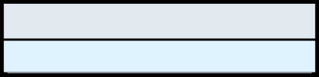
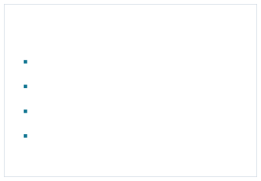

DATA PREPARATION
Cleanups and splits are made to maintain temporal validity.
Step
Notebook decision
Leakage control
Cleaning
291 NaN rows removed after new feature is formed
No random split is used.
Permutation importance is calculated on the validation set. The test set is used only for final evaluation.
Rolling prices use yesterday's actual prices, not chained cumulative predictions.
Alignment
aligned date index for NVDA, VIX, SMH, SPY, QQQ, and target
Scaling
RobustScaler on BiLSTM sequences; other model pipelines as needed
Split
Train 4,570 | validation 979 | test 980 with time sequence
Target
Tomorrow's Target_Return (Percentage)
Implication: more conservative results, but better suited for time-series forecasting.
Source: MachineLearningFinalBanget (1).ipynb
08

Slide 14

MODEL TRAINING
Experiments compare tree, sequence, linear, kernel, and ensemble models.
Family
Model
Selected features
Objective
Tree
Random Forest
20
Non-linear baseline and feature ranking
Boosting
XGBoost
20
non-linear interactions and regularized boosting
Boosting
LightGBM
20
fast tree boosting and baseline interpretation
Sequence
BiLSTM-Attention
20
temporal pattern with attention and sequence time_steps=10
Linear
Ridge Regression
20
regularized linear baseline
Kernel
SVR
15
kernel/linear model compared directly with CEEJ
Ensemble
Stacking Ridge Meta (RF, XGB, LGBM, BiLSTM; SVR)
4 base
test whether the base learner combination gives an edge
Source: MachineLearningFinalBanget (1).ipynb
09

Slide 15
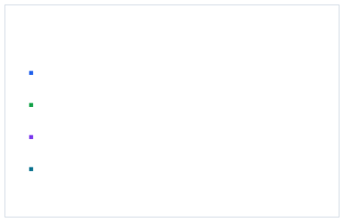
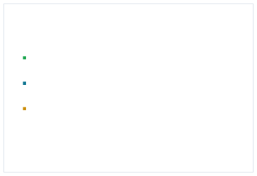
EVALUATION METRICS
The results are read from two sides: return quality and rolling price quality.
Return metrics
Rolling price metrics
MAE: average absolute return error.
MAE price: average difference between actual and predicted USD.
RMSE: error return with a larger penalty for outliers.
R2: ability to explain variation in returns.
MAPE price: percentage error, easily compared across price levels.
3-month DA: true direction as of the last presentation window.
Directional Accuracy: percentage of correct return direction.
Source: MachineLearningFinalBanget (1).ipynb
10

Slide 16
MODEL EVALUATION RESULTS
BiLSTM is superior in DA return, while XGBoost/RF is slightly superior in RMSE.
Model
Feature
MAE
RMSE
R2
DA
Random Forest
20
0.02291
0.03172
-0.00317
54.08%
XGBoost
20
0.02289
0.03172
-0.00304
54.59%
LightGBM
20
0.02291
0.03174
-0.00448
54.49%
BiLSTM-Attention
20
0.02285
0.03173
-0.00554
54.85%
Ridge
20
0.04121
0.05404
-1.91128
52.96%
SVR
15
0.02324
0.03210
-0.02768
54.59%
Stacking Ridge Meta (RF, XGB, LGBM, BiLSTM; SVR)
4 base
0.02300
0.03202
-0.02303
50.47%
Interpretation: return performance between models is very close, R2 is still negative, and ensemble stacking does not automatically outperform a single model.
Source: MachineLearningFinalBanget (1).ipynb
11

Slide 17
COMPETITIVE COMPARISON
Competitive comparison table
Aspect | CEEj 2021 | This Notebook | Implications
Dataset | NVDA daily returns, 01/2012-12/2018; test 07/2018-12/2018 | NVDA yfinance 1999-2026; 6,529 rows ready to use | Notebook wins in latest time coverage
Initial features | >350 independent variables: technical, fundamental, behavioural, Nvidia- market proxies | 71 features: technical, VIX/SMH, IV proxy, earnings, lag/momentum, volume flow, relative strength | CEEj is broader; notebooks are more focused and easier to replicate
Model | SVR, KNN, XGBoost, LGBM, LSTM, ARIMA/ARIMAX, ranking ensemble | RF, XGBoost, LightGBM, BiLSTM-Attention, Ridge, SVR, Stacking | Notebook adds BiLSTM-Attention and XAI
Best result | SVR stationary best: RMSE .036014, MAE .024916; stationary ensemble RMSE .036106 | BiLSTM DA 54.85%; XGBoost/RF RMSE .03172; LightGBM rolling price MAE $2.05 | Similar findings: ensembles don't automatically win
Sources: Chlebus et al. 2021 CEEJ; notebook output
12

Slide 18
COMPETITIVE TABLE
Selected features and metrics indicate a competitive notebook, but not apple-
to-apple with CEEJ.
Initial dataset&features: CEEJ uses NVDA2012-2018 with >350 variables; notebook uses NVDA 1999-2026 with 71 features.
Algorithm
CEEj selected features
CEEj test metrics
Selected feature notebooks
Notebook test metrics
SVR
20 stationary; 27 S+NS
S: RMSE .036014 | MAE .024916 | MedAE .016682
15: rolling std/lag close, alpha_QQQ, return, MACD, VIX
RMSE .03210 | MAE .02324 | R2 -.02768 | DA 54.59%
XGBoost
27 stationary; 74 S+NS
S: RMSE .038848 | MAE .027218 | MedAE .019780
20: alpha_SPY/QQQ, VIX, return, volume, ROC, RSI, MFI
RMSE .03172 | MAE .02289 | R2 -.00304 | DA 54.59%
LightGBM
43 stationary; 80 S+NS
S: RMSE .038870 | MAE .026283 | MedAE .016467
20: RSI, volume, return, lag volume/close, rolling, Bollinger
RMSE .03174 | MAE .02291 | R2 -.00448 | DA 54.49%
LSTM/BiLSTM
20 stationary; 20 S+NS
S: RMSE .036705 | MAE .024918 | MedAE .016772
20: sequence time_steps=10, BiLSTM-Attention
RMSE .03173 | MAE .02285 | R2 -.00554 | DA 54.85%
Ensemble
5-model stationary ensemble
RMSE .036106 | MAE .024094 | MedAE .015307
4 base: RF, XGB, LGBM, BiLSTM; SVR dropped
RMSE .03202 | MAE .02300 | R2 -.02303 | DA 50.47%
Catatan: CEEJ memakai RMSE/MAE/MedAE return; notebook menambah R2, DA, dan rolling price metrics. Periode data dan split berbeda.
Sources: CEEJ Tables 2, 4, 7, 8, 9; notebook saved outputs
13

Slide 19


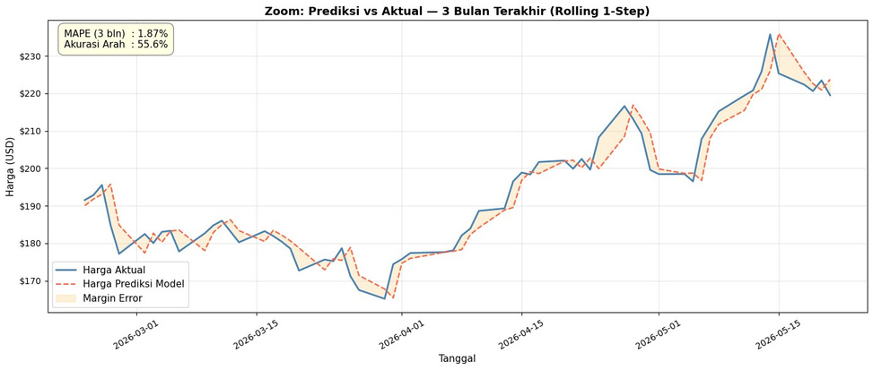

ROLLING PLOT -RANDOM FOREST
Random Forest.
Key metrics
1.87%
55.6%
$2.07
0.03172
3M MAPE
3M DA
Full price MAE
Return RMSE
Selected features: momentum_30d, VIX_MA5, lag_return_14, lag_volume_30, RSI, Bollinger.
Predictions tend to lag when the price moves sharply.
Source: notebook output, rolling 1-step plots and metrics
15

Slide 20

ROLLING PLOT -XGBOOST
XGBoost
Key metrics
1.87%
57.1%
$2.06
0.03172
3M MAPE
3M DA
Full price MAE
Return RMSE
Powerful features: alpha_vs_SPY, VIX_Close, Today's_Return, alpha_vs_QQQ, Volume.
Most competitive in terms of return RMSE
along with Random Forest.
Source: notebook output, rolling 1-step plots and metrics
16

Slide 21
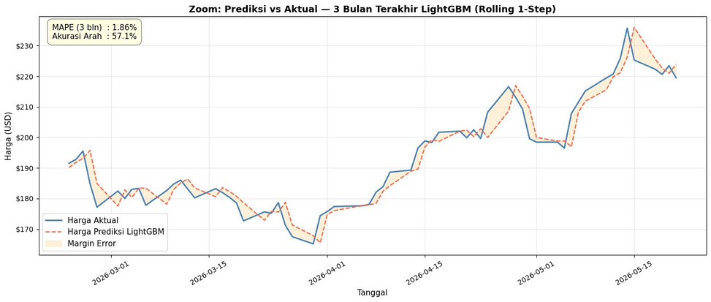
ROLLING PLOT -LIGHTGBM
LightGBM is the cleanest tree-based model for rolling prices.
Key metrics
1.86%
57.1%
$2.05
0.03174
3M MAPE
3M DA
Full price MAE
Return RMSE
Powerful features: RSI_14, Volume, Today's Return, volume/close lag, rolling mean/standard deviation, Bollinger Bands.
Used as a baseline for interpretation in previous decks.
Source: notebook output, rolling 1-step plots and metrics
17

Slide 22
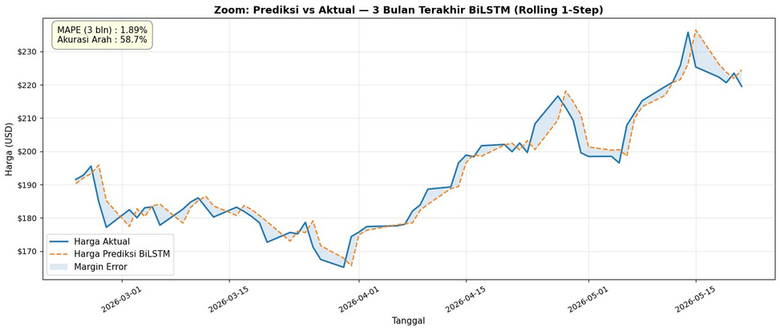
ROLLING PLOT -BILSTM-ATTENTION
BiLSTM-Attention gives the highest directional accuracy on test returns and the last 3 months.
Key metrics
1.89%
58.7%
$2.10
54.85%
3M MAPE
3M DA
Full price MAE
Return DA
Sequence time_steps=10 with 20 selected features.
This model is a prime candidate for XAI BiLSTM.
Source: notebook output, rolling 1-step plots and metrics
18

Slide 23
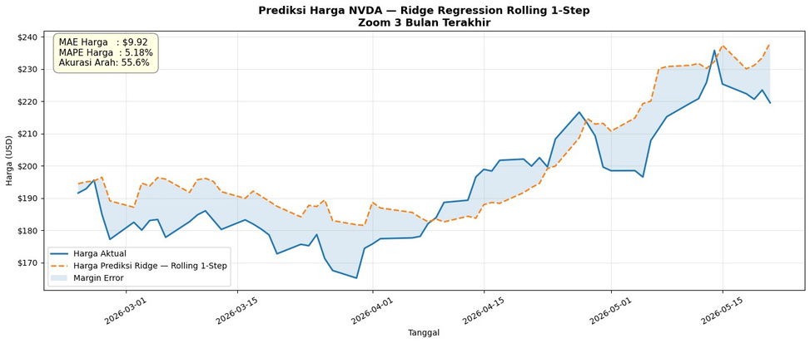
ROLLING PLOT -RIDGE REGRESSION
Ridge is a linear baseline, but the 3-month price error is the largest.
Key metrics
$9.92
5.18%
55.6%
0.05404
3M MAE
3M MAPE
3M DA
Return RMSE
The selected features are mostly based on lag_close, rolling_std, MACD, VIX, and alpha_vs_QQQ.
It occasionally wins, but
fails to maintain price levels.
Source: notebook output, rolling 1-step plots and metrics
19

Slide 24
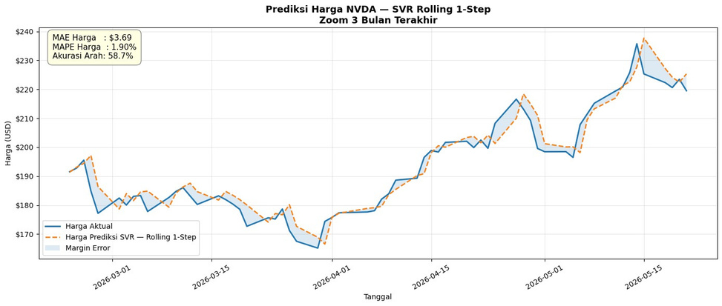
ROLLING PLOT -SVR
The strongest SVR in the 3-month window in terms of MAPE and DA.
Key metrics
$3.69
1.90%
58.7%
0.03210
3M MAE
3M MAPE
3M DA
Return RMSE
Selected features: rolling_std, lag_close, alpha_vs_QQQ, return, MACD, VIX, volume.
In line with CEEJ 2021: SVR can be very competitive with NVDA returns.
Source: notebook output, rolling 1-step plots and metrics
20

Slide 25
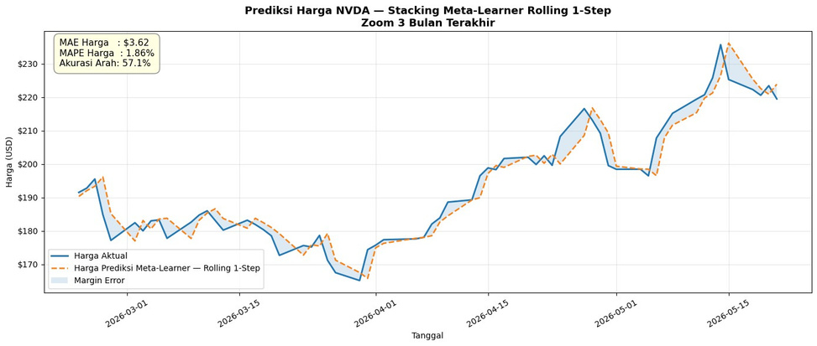
ROLLING PLOT -STACKING META-LEARNER
Stacking lowers 3-month MAPE, but DA test return drops.
Key metrics
$3.62
1.86%
57.1%
50.47%
3M MAE
3M MAPE
3M DA
Return DA
Final base learners: RF, XGBoost, LightGBM, BiLSTM-Attention; SVR was discarded due to constant predictions.
Conclusion: ensembles do not automatically
outperform single models.
Source: notebook output, rolling 1-step plots and metrics
21

Slide 26

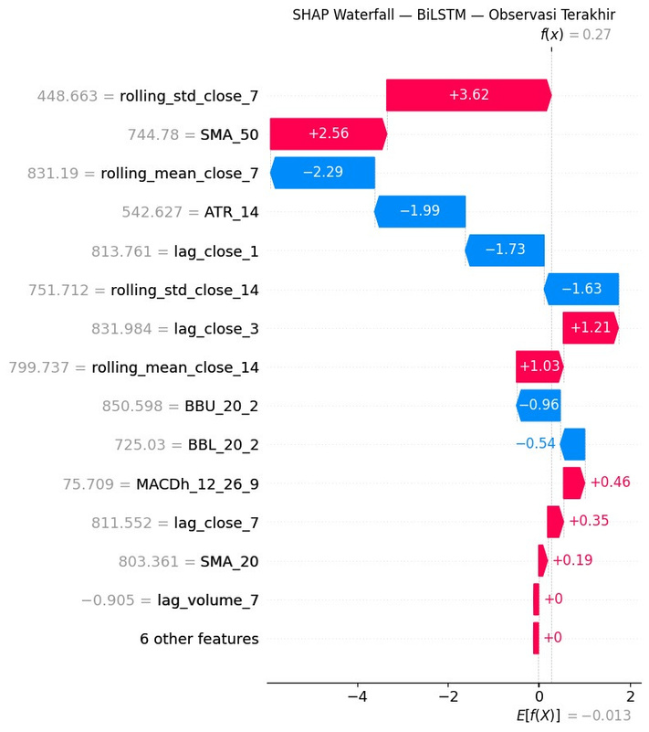

XAI -SHAP WATERFALL
XAI SHAP BiLSTM
Main reading
The biggest positive driving features are: rolling_std_close_7 (+3.62) and SMA_50 (+2.56).
The biggest suppressing features are: rolling_mean_close_7 (-2.29), ATR_14 (-1.99), lag_close_1 (-1.73).
The final predicted value of f(x) is approximately 0.27 from the baseline E[f(X)] = -0.013.
Interpretation: Volatility and moving averages are more dominant than volume features in the last observation.
Source: supplied SHAP BiLSTM image; notebook feature set
22

Slide 27

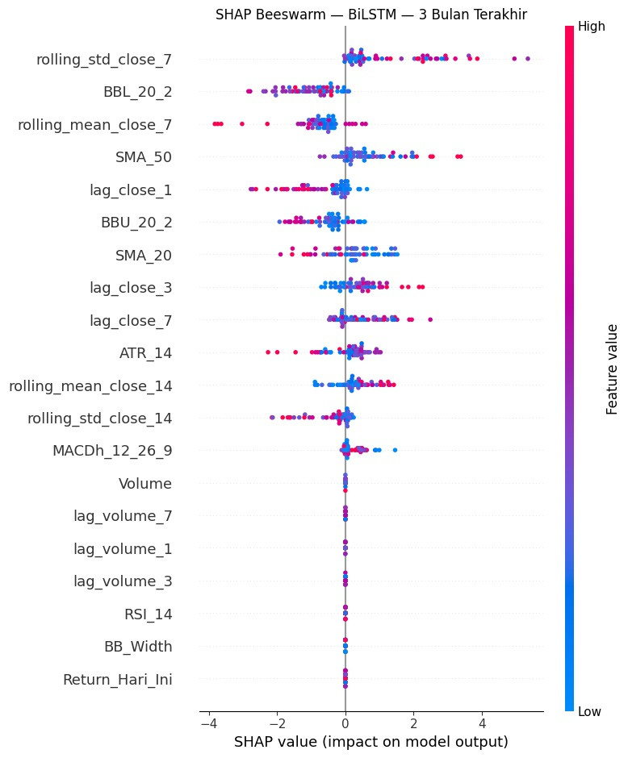
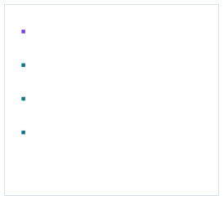
XAI -SHAP BEESWARM
Over the past 3 months, the biggest feature impacts still come from volatility, price bands, and close lag.
rolling_std_close_7 has the widest positive SHAP distribution.
BBL_20_2 and rolling_mean_close_7 often have negative impacts.
SMA_50, lag_close_3, and lag_close_7
more often drive positive output.
The volume and Return_Today_features appear small in this XAI window.
Source: supplied SHAP BiLSTM image; notebook feature set
23

Slide 28
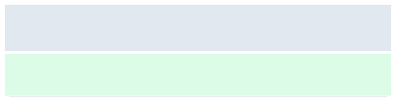


CONCLUSION
The pipeline successfully builds a complete NVDA prediction baseline, but the results should be read conservatively.
Findings
Contents
Limitation
DA's best model
BiLSTM-Attention: DA return 54.85%; rolling 3 months DA 58.7%
The R2 test is still negative in all main models.
Strong rolling model
LightGBM and Stacking: 3-month MAPE 1.86%; SVR strong on 3-month DA
Directional accuracy only gives a thin edge.
There is no backtest trading with transaction costs and slippage.
A walk-forward recalibration is needed for more realistic deployment.
Research finding
In line with CEEJ: single models can outperform ensembles
XAI
SHAP BiLSTM highlights volatility and price levels as dominant features
Final recommendation: use BiLSTM/SVR/LightGBM as advanced candidates, then validate with walk-forward and trading simulation.
Source: MachineLearningFinalBanget (1).ipynb
24

